Slide 1
RSS Feed Contextualized Search
Notes:
Discuss utilizing some basic NLP tools in order to grab a subset of document from a collection that pertain to a “seed” or search doc

Slide 2
Outline
Collecting & Organizing RSS Feeds
Scraping & Storing Articles
Document-Term Lookup Tables
Search via Document Seeding
Notes:
+ Main steps in the process: start to end / full pipe
+ various sites / sources used
+ code is python, db is mysql

Slide 3
Collecting & Organizing Feeds
Python & XML Files
  Scrape from “Master” Pages

Slide 4
Scraping & Storing Articles
cron Job
  0500 – 1900, M-F
Tor Sockets
Python “feedparser”
Dump to MySQL
  Link vs. (Title, Pub Date) Keys vs. neither → duplicate problem
Example Log Report
Notes:
+ run only during the week days bc not sure how mucb stuff on weekends
+ next update: use info from log to determine which feeds likely update on weekends, update xmls, code to be more flexible
+ tor not really needed, but interesting
+ duplicate articles!
+ same article, but in diff feed → some sites present as diff urls in the feed, thus pass the “dupe” test
+ some feeds don’t like pub dates, so title + pd combo not good
+ deal with when processing

Slide 5
Doc-Term Lookup Tables
Word Table
  (word_id, word_text)
Word – Doc – Word Count Table
  (word_id, doc_id, word_count)
Word Summary Info Table
  (word_id, n_docs, n_total)
Allows us to query Document BOWs
  Cons: Cannot add new features “on the fly” and need to store *most* features we want to use / all that we want to search on
Notes:
+ store bows for docs for all “tokens”
+ textacy preprocess + spacy tokenize
+ likely need to improve with additional features, but fairly expensive
+ summary table makes analysis life easier / filtering words / tokens

Slide 6
Localized Search
Seed the Search with a Document
Restrictive Word use to “Grow” Document Search Space
  Filtering based on DF (collection and / vs. local)
JMS scores on BOWs
  Reduced doc space --> reduced comp. complex.
Graph Based vs. “Nearest Neighbor”
Notes:
Process flow:
+ parse seed doc to bows
+ remove stop words, “frequent” words (> 50 docs currently) → l01_words
+ query docs with l01_words → l01_docs
+ get all words for l01_docs
+ filter words from l01_docs → l02_words
+ query all docs with l02_words → l02_docs
+ for [orig, l01_docs, l02_docs] query all words in [orig_words, l01_words, l02_words] to get doc bows
+ compute JMS
JMS:
Select cutoff / top n
Graph:
Make score matrix symmetric
Cluster

Slide 7
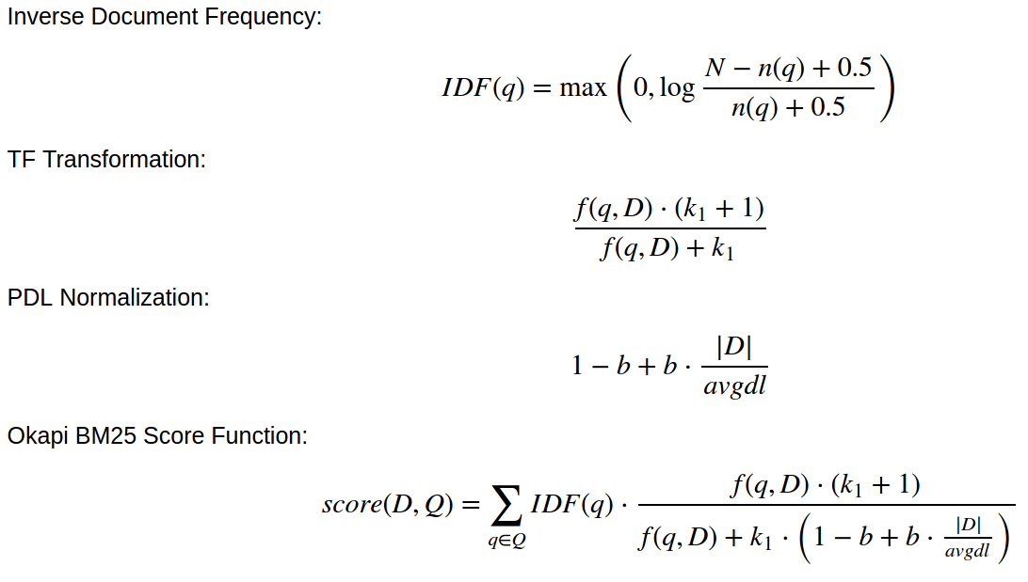
Overview of Okapi BM25 VSM

Slide 8
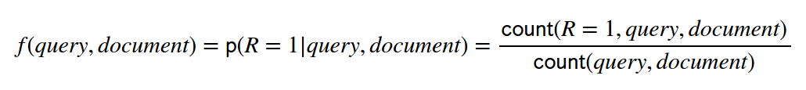
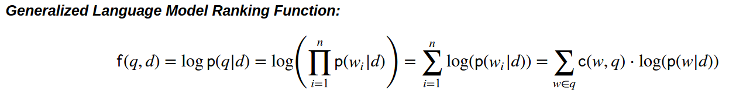
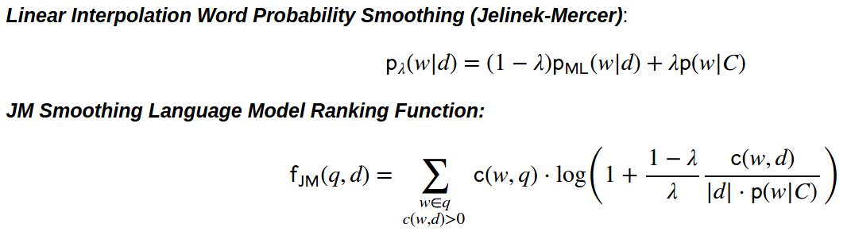
Overview of JMS LM

